Slide 1

DOMAIN & REQUIREMENT ANALYSIS
Presented by,
Team ALPHA

Slide 2
TEAM MEMBERS :
Sheik Fareeth H : sheikfareet.heera@aspiresystems.biz
Gokul P : gokul.prathaban@aspiresystems.biz
Deepika S : deepika.senthil@aspiresystems.biz
Vinoth J : vinoth.jayakumar@aspiresystems.biz
Prithviraj SP : prithviraj.palanisamy@aspiresystems.biz
Aravindhan Ra : aravind.rangaraj@aspiresystems.biz
Remuki J S : remuki.soundar@aspiresystems.biz
Kumaresh K S: kumareshk.suresh@aspiresystems.biz
Vishnu Prakaash R : vishnu.ravi@aspiresystems.biz
Darshana A: darshana.annappan@aspiresystems.biz

Slide 3
Domain : TELECOMMUNICATION
Website : KOVAI FIBRENET
Kovai Fibernet
FUNCTIONALITY :
To provide good speed fiber net connection to their customers(End users).
To provide Online payment for their internet service.
To update Users with new plans.
To display the data usage and remaining validity for their user.
To provide services and support to their users.

Slide 4
REQUIREMENTS :
FUNCTIONAL REQUIREMENTS :
To provide uninterrupted internet services to their customers.
To provide Online payment for their customers.
User should receive speed according to the user's plan.
NON - FUNCTIONAL REQUIREMENTS :
Data usage
Data validity
Support
Displaying new plans
Session time
Bills
Multiple payment gateways

Slide 5
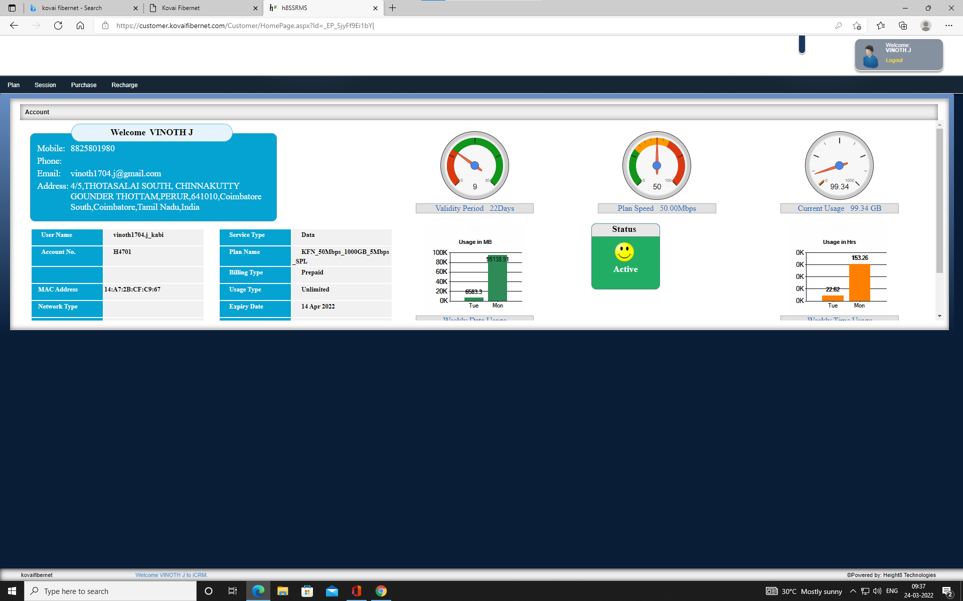
PAIN POINTS & USABILITY :
Poor user interface
Many not used jazzy features in home page & unable to access in full screen
You can't go to the home page, once you moved to the other pages

Slide 6
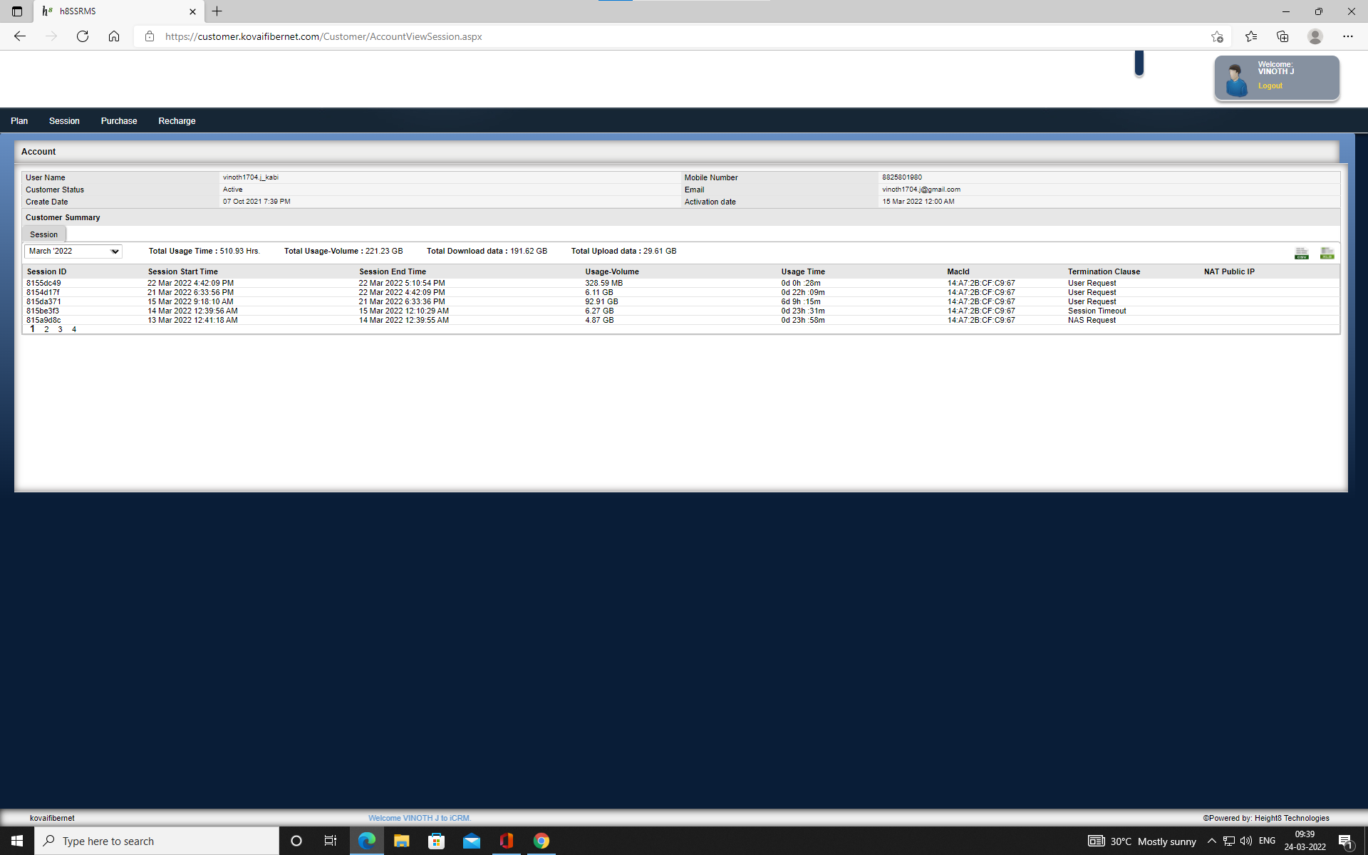
PAIN POINTS & USABILITY :
We can't able to get the data usage whenever we want , we can only see the data usage when the connection is interrupted.
We have to navigate through multiple pages to complete the payment.

Slide 7
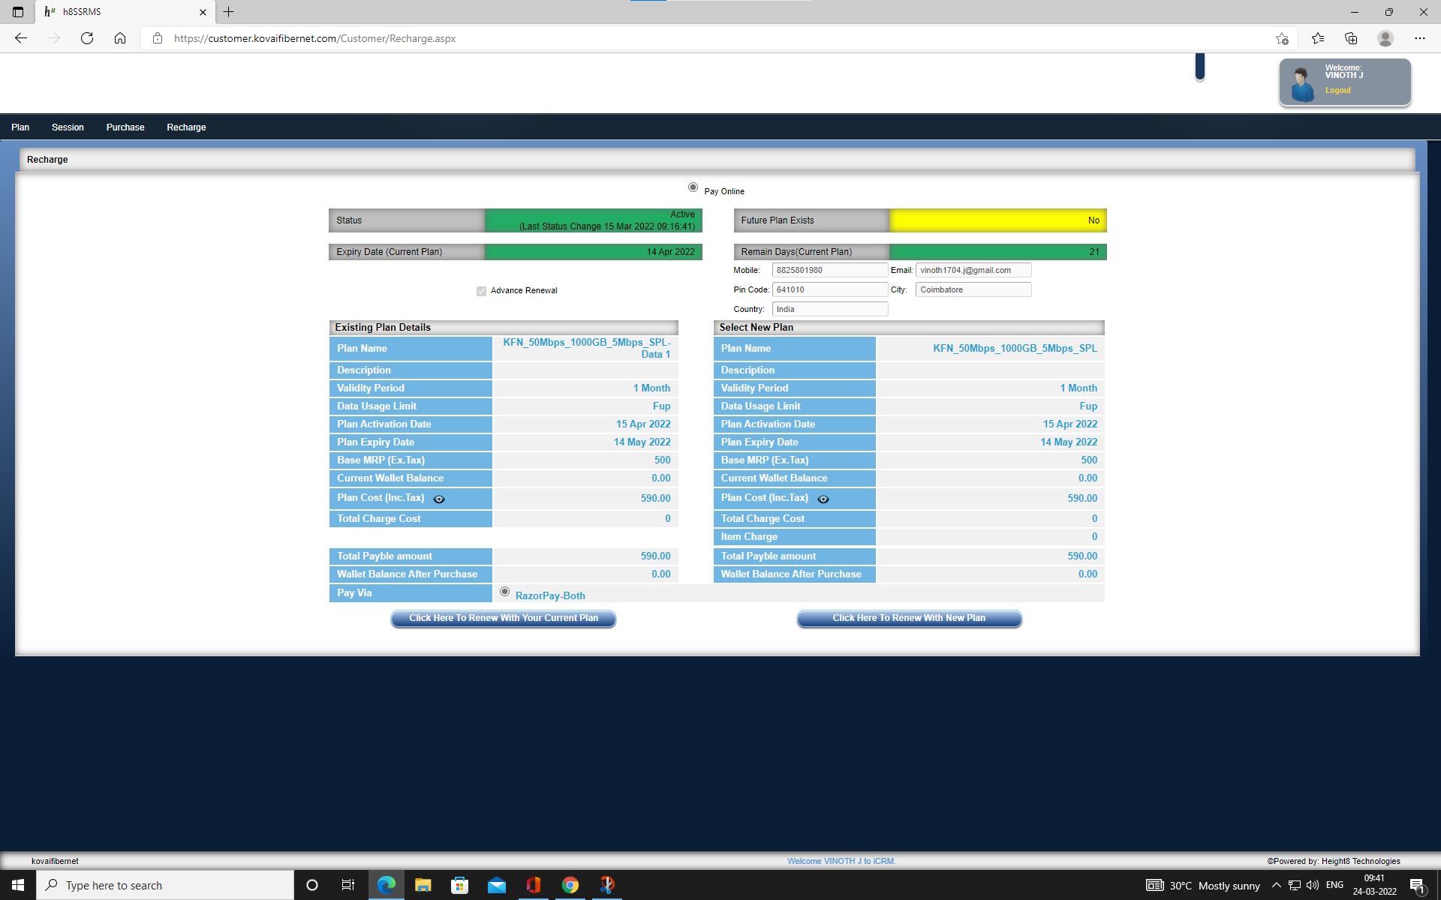
PAIN POINTS & USABILITY :
We can't change the existing plan even though there is an option for changing the plan.
Worst model for the tracking of data and plan validity.

Slide 8
THANK YOU!

